Slide 1
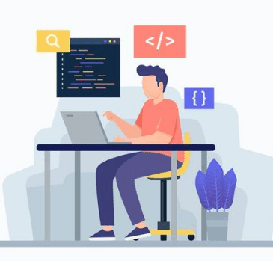
CS 703 Applied Data Science Project Weekly Status Report
Professor Nicholas Nardi
Spring 2026

Slide 2
Predictive Pricing Analysis for The USA Housing Market Status Report Week Ending May 9, 2026 Submitted by Gordon Oboh May 10, 2026

Slide 3
Agenda…
Status Overview…
Items Completed in Current Week…
Items In Progress…
Items To Be Started…
Samples of Items Completed This Week…
Issues, Risks, Concerns…
Next Steps…
Personal Reflection…

Slide 4
Status Overview…
Project Status is Yellow
1.0 Business Understanding — in progress; business problem identified
Original Start: May 4, 2026 | Revised Start: N/A | Actual Start: May 4, 2026
Original End: May 9, 2026 | Revised End: N/A | Actual End: N/A
Dataset search ongoing; suitable rental listing data not yet confirmed
Phase 1: Project Proposals — completed
Original Start: May 4, 2026 | Revised Start: N/A | Actual Start: May 4, 2026
Original End: May 9, 2026 | Revised End: N/A | Actual End: May 9, 2026
No other major issues

Slide 5
Items Completed in Current Week…
Phase 1: Project Proposals Document
Task is GREEN — 100% complete
Original Start: May 4, 2026 | Revised Start: N/A | Actual Start: May 4, 2026
Original End: May 9, 2026 | Revised End: N/A | Actual End: May 9, 2026
Documented two candidate data science projects; primary focus confirmed as housing amenity impact on U.S. rental pricing
Submitted to Professor Nardi for review

Slide 6
Items In Progress…
1.0 Business Understanding
Task is Yellow — 75% complete
Original Start: May 4, 2026 | Revised Start: N/A | Actual Start: May 4, 2026
Original End: May 9, 2026 | Revised End: N/A | Actual End: N/A
Business problem and scope are defined; awaiting dataset confirmation
Anticipate completing 1.0 Business Understanding once data source is secured

Slide 7
Items to Be Started…
1.1 Determine Business Objectives (subsection of current 1.0)
Original Start: May 10, 2026 | Revised Start: N/A | Actual Start: N/A
Original End: May 11, 2026 | Revised End: N/A | Actual End: N/A
1.2 Assess Situation
Original Start: May 11, 2026 | Revised Start: N/A | Actual Start: N/A
Original End: May 12, 2026 | Revised End: N/A | Actual End: N/A
2.0 Data Understanding (next CRISP-DM phase)
Original Start: May 13, 2026 | Revised Start: N/A | Actual Start: N/A
Original End: May 24, 2026 | Revised End: N/A | Actual End: N/A

Slide 8
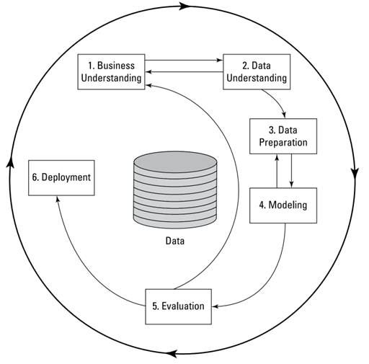
Sample of Items Completed This Week…
CRISP-DM Methodology — Project Framework
The diagram below shows the CRISP-DM process model guiding this project.
Phase 1.0 Business Understanding is the current active phase.

Slide 9
Project Issues, Risks, Concerns…
Issues
None at this time
Risks
Dataset availability: a suitable publicly accessible rental listing dataset may not exist
Impact: project scope or direction may need revision
Mitigation: evaluating Kaggle, UCI, and government housing data repositories
Concerns
None at this time

Slide 10
Next Steps…
Complete 1.0 Business Understanding
Original Start: May 4, 2026 | Revised: N/A | Actual Start: May 4, 2026
Original End: May 9, 2026 | Revised: N/A | Actual End: N/A
1.1 Determine Business Objectives
Original Start: May 10, 2026 | Revised: N/A | Actual Start: N/A
Original End: May 11, 2026 | Revised: N/A | Actual End: N/A
1.2 Assess Situation
Original Start: May 11, 2026 | Revised: N/A | Actual Start: N/A
Original End: May 12, 2026 | Revised: N/A | Actual End: N/A
Begin 2.0 Data Understanding
Original Start: May 13, 2026 | Revised: N/A | Actual Start: N/A
Original End: May 24, 2026 | Revised: N/A | Actual End: N/A

Slide 11
Personal Reflection…
Week 1 has been a grounding experience. Defining the business problem forced me to think beyond just "what can I model" and toward "what question actually matters." That shift in framing took more effort than expected, but it feels like the right foundation.
The main thing on my mind is the data. I know the direction I want to go, but without a confirmed dataset, everything else is provisional. I am cautiously optimistic but aware that this uncertainty needs to resolve early before it affects the rest of the project.

Slide 12
Thank You!...

